Slide 1
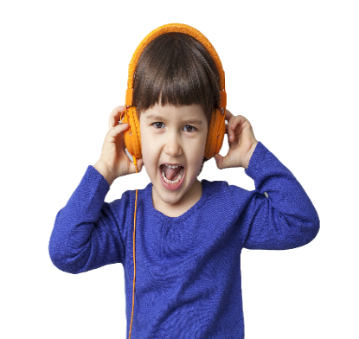
Who is this service for?
Our service is available to children and young people 0-18 years who have a diagnosis of Autism . Our website is available for everyone and offers a wide range of information and resources.
Telford & Wrekin
Children's Autism Hub
To access our Children’s Autism Hub you need to be a resident of Telford and Wrekin.
HOW TO FIND US
Children & Young People
0-18
We are based at Telford Centre, so its easy to get to us by car, bus or train!
Plus, there's plenty of parking too!
AUGUST 2021 version 05/08/2021
GET IN TOUCH
Telford & Wrekin CVS
Suite 12 and 15
Second Floor
Hazledine House
Central Square
Telford
TF3 4JL
Phone: 01952 262062
E-mail: someone@example.com
Facebook:
Website: https://www.telfordautismhub.org.uk/

Slide 2
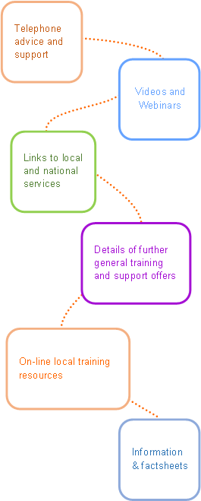
 |  | Information & factsheets On-line local training resources Links to local and national services Videos and Webinars Telephone advice and support Details of further general training and support offers
Our Children's Autism Hub provides...
About Autism
Autism Spectrum Condition is a lifelong developmental condition that affects the way a person:
Communicates and interacts with others
Experiences their senses
Thinks and behaves flexibly
This means that autistic people can have difficulties with everyday life. Autism is referred to as a spectrum because each person is different, and it is important to remember that each person will have their own strengths and weaknesses. With the right understanding and support, autistic people can lead full and rewarding lives.
Family play sessions…
Welcome to Telford & Wrekin Children and Young Peoples Autism Hub!
[https://autismwestmidlands.org.uk/]
We offer a wide range of support along with opportunities to meet with other families and professionals.
What we believe
Telephone information advice and guidance
We believe in the empowerment of children and young people with autism to live a full and active life.
Our work is based around child centred principles focused on building up and celebrating the individual strengths and gifts of each child.
We actively support parental and caring responsibilities encouraging parental confidence and knowledge to support their child with autism, to flourish.
Supporting young people with their transition into the Adult Autism Hub
Workshops
Some of the main signs that a child may be on the autism spectrum include:
Not drawing their parents’ or others’ attention to objects or events, for example not pointing at a toy or a book, or at something that is happening nearby (or a child may eventually do this, but later than expected)
Carrying out activities in a repetitive way, for example always playing the same game in the same way, or repeatedly lining toys up in a particular order
Resistance to change or doing things differently
Emerging difficulties with social interaction and social communication
Behaviour such as biting, pinching, kicking, pica (putting inedible items in the mouth), or self-injurious behaviour.
Children can be diagnosed as autistic when they’re quite young, in some cases from the age of two. But not everyone is diagnosed early in life. It’s quite common for a child to not get their diagnosis until they are older, or even an adult, particularly if they don’t have accompanying learning disabilities.

